Slide 1
Chapter – 22
Kickstart Installations

Slide 2
Objectives:
At the end of this module, you would have gained fair knowledge on:
What is a Kickstart Installation
How to perform a Kickstart Installation

Slide 3
Many system administrators would prefer to use an automated installation method to install Red Hat Linux on their machines. To answer this need, Red Hat created the kickstart installation method.
Using kickstart, a system administrator can create a single file containing the answers to all the questions that would normally be asked during a typical Red Hat Linux installation.
Kickstart files can be kept on single server system, and read by individual computers during the installation. This installation method can support the use of a single kickstart file to install Red Hat Linux on multiple machines, making it ideal for network and system administrators.

Slide 4
Kickstart lets you automate most of a Red Hat Linux installation, including:
• Language selection
• Mouse configuration
• Keyboard selection
• Boot loader installation
• Disk partitioning
• Network configuration
• NIS, LDAP, Kerberos, Hesiod, and Samba authentication
• Firewall configuration
• Package selection
• X Window System configuration

Slide 5
Kickstart installations can be performed using a local CD-ROM, a local hard drive, or via NFS, FTP, or HTTP.
To use kickstart, you must:
1. Create a kickstart file.
2. Create a boot disk with the kickstart file or make the kickstart file available on the network.
3. Start the kickstart installation.

Slide 6
Creating the Kickstart File
Kickstart Configurator allows you to create a kickstart file using a graphical user interface, so that you do not have to remember the correct syntax of the file.
After choosing the kickstart options, click the Save File button, verify the options you have chosen, and save the kickstart file to a desired location.
To use Kickstart Configurator, you must by running the X Window System.

Slide 7
To start Kickstart Configurator, use one of the following methods:
On the GNOME desktop, go to the Main Menu Button (on the Panel) => Programs => System => Kickstart Configurator.
• On the KDE desktop, go to the Main Menu Button (on the Panel) => System => Kickstart Configurator.
• Type the command /usr/sbin/ksconfig at a shell prompt (for example, in an XTerm or GNOME terminal).

Slide 8
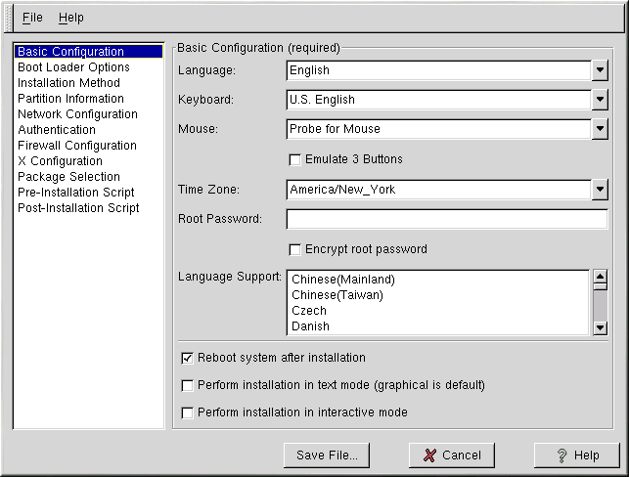
Basic Configuration

Slide 9
Choose the language to use during the installation from the Language menu. Select the system keyboard type from the Keyboard menu.
Choose the mouse for the system from the Mouse menu. If you choose No Mouse, no mouse will be configured. If you choose Probe for Mouse the installation program will try to autodetect the mouse. Probing works for most modern mice.
If you have a two-button button mouse, you can emulate a three-button mouse by selecting Emulate 3 Buttons. If this option is selected, simultaneously clicking the left and right mouse buttons will be recognized as a middle mouse button click.

Slide 10
From the Time Zone menu, choose the time zone to use for the system.
Enter the desired root password for the system in the Root Password text entry box. If you want to save the password as an encrypted password in the file, select Encrypt root password. When the file is saved, the plaintext password that you typed will be encrypted and written to the kickstart file. Do not type an already encrypted password and select to encrypt it.
Choose one or more languages to install and use after installation from the Language Support list.
Choosing Reboot system after installation will reboot your system automatically after the installation is finished.

Slide 11
Kickstart installations are performed in graphical mode by default. To override this default and use text mode instead, check the Perform installation in text mode button.
You can perform a kickstart installation in interactive mode. This means that the installation program will use all the options pre-configured in the kickstart file, but it will allow you to preview the options in each screen before you can continue to the next screen.
To continue to the next screen, click the Next button after you have approved the settings. If you are not satisfied with the pre-configured options, you can change them before continuing the installation. If you prefer this type of installation, check the Perform installation in interactive mode button.

Slide 12
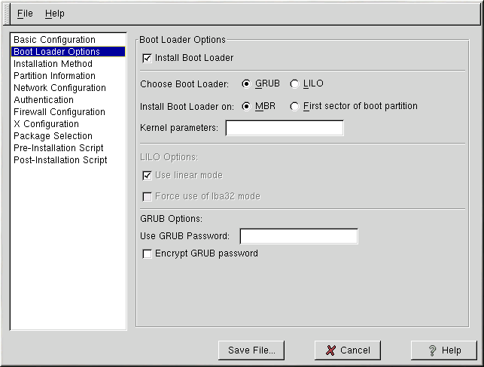
Boot Loader Options

Slide 13
You have the option of installing GRUB or LILO as the boot loader. If you do not want to install a boot loader, uncheck Install Boot Loader.
If you choose not to install a boot loader, make sure you create a boot disk or have another way to boot your Red Hat Linux system.
If you choose to install a boot loader, you must also choose which boot loader to install (GRUB or LILO) and where to to install the boot loader (the Master Boot Record or the first sector of the /boot partition).
Install the boot loader on the MBR if you plan to use it as your boot loader. If you are using a different boot loader, install LILO or GRUB on the first sector of the /boot partition and configure the other boot loader to boot Red Hat Linux.

Slide 14
If you need to pass any special parameters to the kernel to be used when the system boots, enter them in the Kernel parameters text field.
For example, if you have an IDE CD-ROM burner, you can tell the kernel to use the SCSI emulation driver that must be loaded before using cdrecord by typing hdd=ide-scsi as a kernel parameter (where hdd is the CD-ROM device).
If you choose LILO as the boot loader, choose whether you want to use linear mode and whether you want to force the use of lba32 mode.

Slide 15
If you choose GRUB as the boot loader, you can password protect it by configuring a GRUB password. Enter a password in the Use GRUB Password text entry area.
If you want to save the password as an encrypted password in the file, select Encrypt GRUB password. When the file is saved, the plaintext password that you typed will be encrypted and written to the kickstart file.
Do not type an already encrypted password and select to encrypt it.

Slide 16
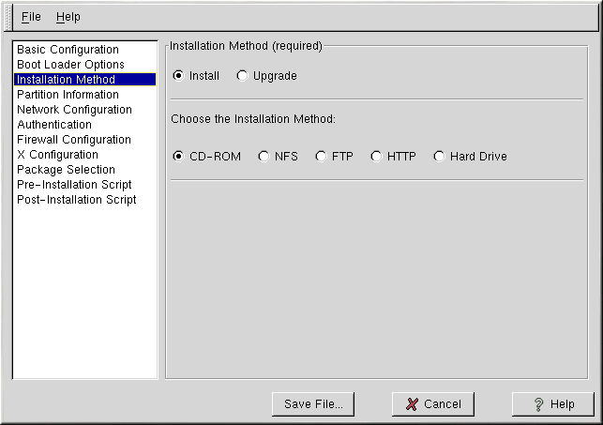
Installation Method

Slide 17
The Installation Method screen allows you to choose whether you want to perform a full installation or an upgrade. If you choose upgrade, the Partition Information and Package Selection options will be disabled. They are not supported for kickstart upgrades.
Also choose the type of kickstart installation to perform from this screen. You can choose from the following options:
• CD-ROM — Choose this option if you wish to install Red Hat Linux from the Red Hat Linux CD-ROMs.

Slide 18
• NFS — Choose this option if you wish to install Red Hat Linux from an NFS shared directory. Two text entry boxes for the NFS server and NFS directory will appear.
• FTP — Choose this option if you wish to install Red Hat Linux from an FTP server. Two text entry boxes for the FTP server and FTP directory will appear. Enter the fully-qualified domain name or IP address of the FTP server.
• HTTP — Choose this option if you wish to install Red Hat Linux from an HTTP server. Two text entry boxes for the HTTP server and HTTP directory will appear. Enter the fully-qualified domain name or IP address of the HTTP server.
• Hard Drive — Choose this option if you wish to install Red Hat Linux from a hard drive. Two text entry boxes for hard drive partition and hard drive directory will appear.

Slide 19
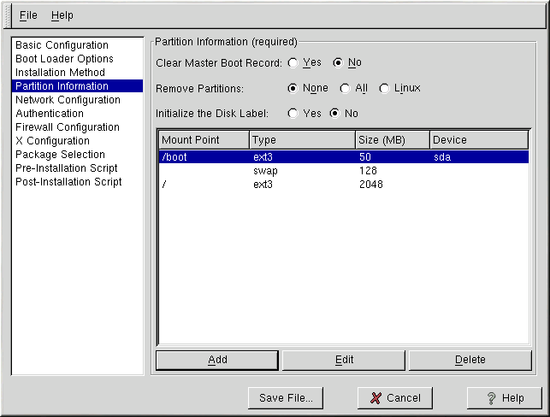
Partition Information

Slide 20
To clear the Master Boot Record, select Yes beside the option on the top of the window. You can choose to keep the existing partitions, remove all the existing partitions, or remove all the existing Linux partitions by selecting None, All, or Linux, respectively, next to Remove Partitions.
You can initialize the disk label to the default for the architecture of the system (msdos for x86 and gpt for Itanium). Choose Yes if you are installing on a brand new hard drive.

Slide 21
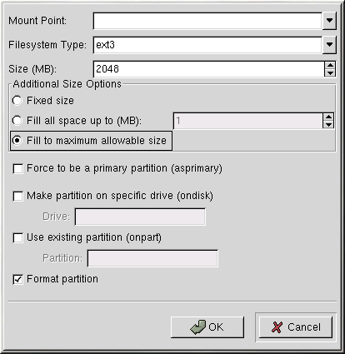
Creating Partitions
To create a partition, click the Add button. The Partition Options window shown in figure below will appear. Choose mount point, filesystem type, and partition size for the new partition.

Slide 22
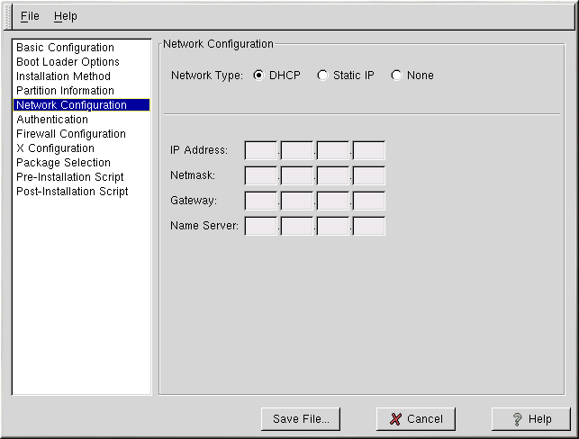
Network Configuration

Slide 23
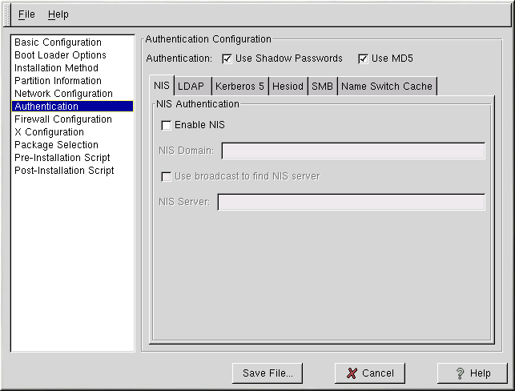
Authentication

Slide 24
The Authentication Configuration options allows you to configure the following methods of authentication:
• NIS
• LDAP
• Kerberos 5
• Hesiod
• SMB
• Name Switch Cache
They are not enabled by default. To enable one or more of these methods, click the appropriate tab, click the checkbutton next to Enable, and enter the appropriate information for the authentication method.

Slide 25
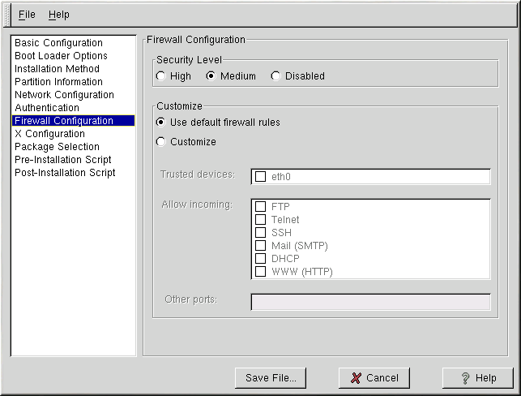
Firewall Configuration

Slide 26
The Firewall Configuration window is identical to the screen in the Red Hat Linux installation program and provides the same functionality.
Choose between High, Medium, and Disabled security levels. Refer to the Official Red Hat Linux Installation Guide for detailed information about these security levels.

Slide 27
X Configuration
If you are installing the X Window System, you can configure it during the kickstart installation by checking the Configure the X Window System button on the X Configuration window as shown in figure below If this option is not chosen, the X configuration options will be disabled and the skipx option will be written to the kickstart file.

Slide 28
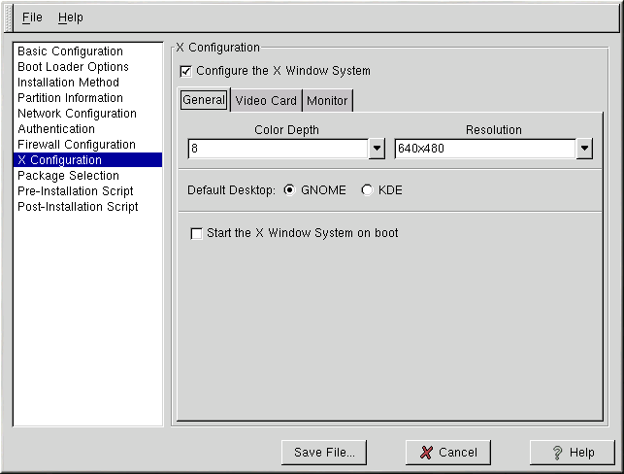
X Configuration

Slide 29
The first step in configuring X is to choose the default color depth and resolution. Select them from their respective pulldown menus. Be sure to specify a color depth and resolution that is compatible with the video card and monitor for the system.
If you are installing both the GNOME and KDE desktops, you need to choose which desktop you want to be the default. If you are just installing one desktop, be sure to choose it. Once the system is installed, users can choose which desktop they want to be their default.

Slide 30
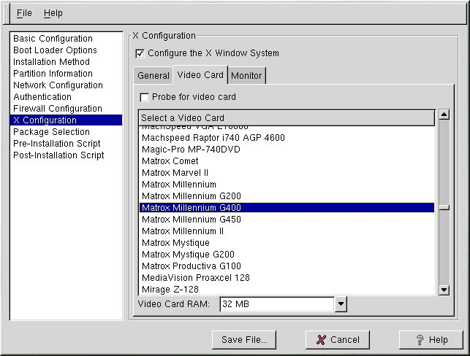
Video Card
Probe for video card is selected by default. Accept this default if you want the installation program to probe for the video card during installation. Probing works for most modern video cards.

Slide 31
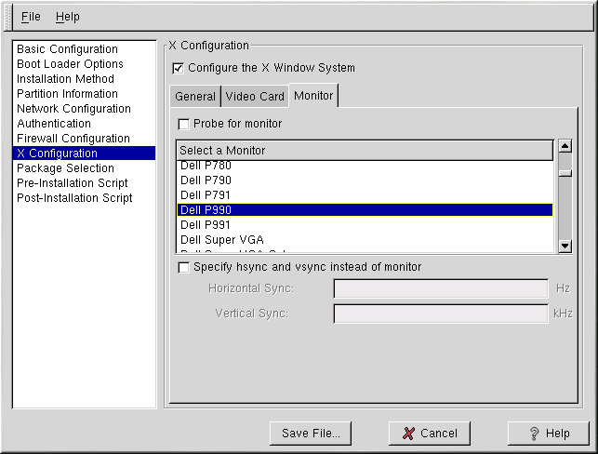
Monitor

Slide 32
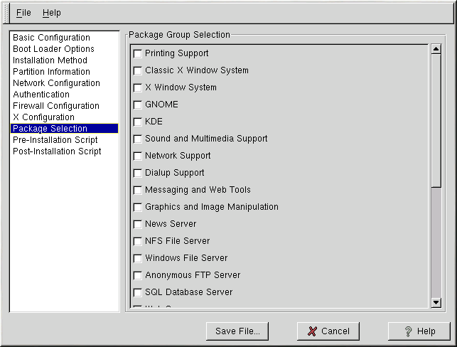
Package Selection
The Package Selection window allows you to choose which package categories to install. Currently, Kickstart Configurator does not allow you to select individual packages. To install individual packages, modify the %packages section of the kickstart file after you save it.

Slide 33
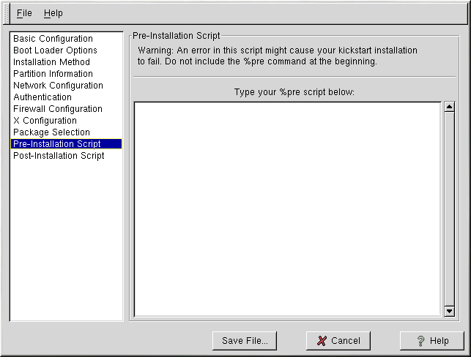
Pre-Installation Script

Slide 34
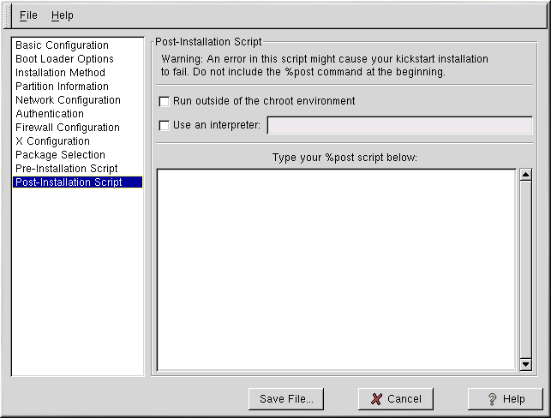
Post-Installation Script

Slide 35
Creating a Kickstart Boot Disk
To perform a diskette-based kickstart installation, the kickstart file must be named ks.cfg and must be located in the boot disk's top-level directory. Note that the Red Hat Linux boot disks are in MS-DOS format, so it is easy to copy the kickstart file under Linux using the mcopy command:
Alternatively, you can use Windows to copy the file. You can also mount the MS-DOS boot disk and cp the file over.

Slide 36
Making the Kickstart File Available on the Network
Network installations using kickstart are quite common, because system administrators can easily automate the installation on many networked computers quickly and painlessly.
In general, the approach most commonly used is for the administrator to have both a BOOTP/DHCP server and an NFS server on the local network.
The BOOTP/DHCP server is used to give the client system its networking information, while the actual files used during the installation are served by the NFS server.

Slide 37
To perform a network-based kickstart installation, you must have a BOOTP/DHCP server on your network, and it must include configuration information for the machine on which you are attempting to install Red Hat Linux.
The BOOTP/DHCP server will provide the client with its networking information as well as the location of the kickstart file.
If a kickstart file is specified by the BOOTP/DHCP server, the client system will attempt an NFS mount of the file's path, and will copy the specified file to the client, using it as the kickstart file.

Slide 38
Starting a Kickstart Installation
To begin a kickstart installation, you must boot the system from a Red Hat Linux boot diskette or the CD-ROM and enter a special boot command at the boot prompt.
If the kickstart file is located on a boot diskette that was created from the boot.img or bootnet.img image file, the correct boot command would be:
boot: linux ks=floppyThe linux ks=floppy command also works if the ks.cfg file is located on a vfat or ext2 filesystem on a floppy diskette and you boot from the Red Hat Linux CD-ROM.

Slide 39
An alternate boot command for booting off the Red Hat Linux CD-ROM and having the kickstart file on a vfat or ext2 filesystem on a floppy diskette is:
boot: linux ks=hd:fd0/ks.cfg If you need to use a driver disk with kickstart, you can still have the kickstart file on a floppy disk:
boot: linux ks=floppy dd The Red Hat Linux installation program looks for a kickstart file if the ks command line argument is passed to the kernel.

